Slide 1


Lecture #1
Professor: Carey Nachenberg (Please call me “Carey”)
E-mail: climberkip@gmail.com
Class info: M/W 10am-12pm, Moore Hall 100 Office hours: Engineering VI Room 289
My Office: Engineering VI Room 297 (for 1-on-1 meetings)
Mondays 12pm-1pm (after class) Wednesdays 9am-10am (before class)

Slide 2
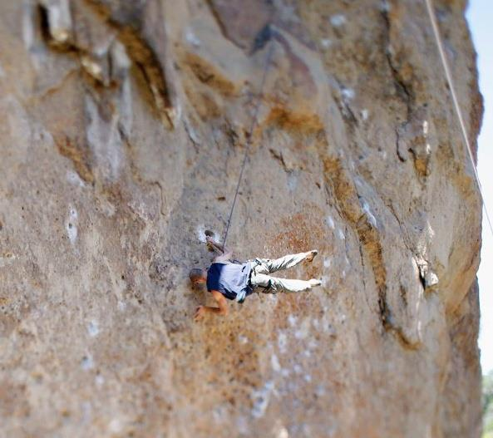

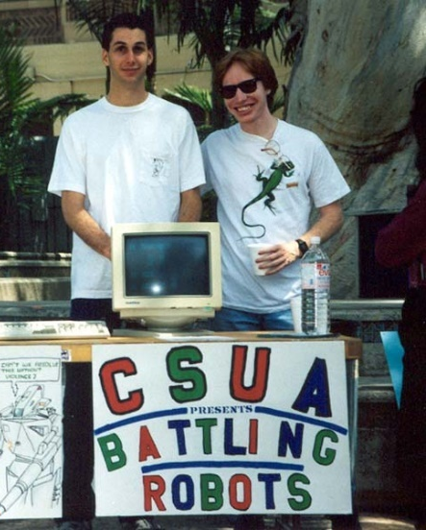

Who Am I?
Carey Nachenberg
Age: 48
School: BS+MS in CS, UCLA ’95
Work: Adjunct Prof at UCLA
Principal Engineer @
Hobbies: Rock climbing, weight training, teaching CS!
My goal: To make an impact on your life (through getting you excited about programming)!

Slide 3

What You’ll Learn in CS32
Advanced C++ Topics
Object Oriented Programming and C++ language features
Data Structures
The most useful data structures (e.g., lists, trees, hash tables)
Algorithms
The most useful algorithms (e.g., sorting, searching)
Building Big Programs
How to write large (> 1,000s of lines of code) programs
Basically, once you complete CS32, you’ll know 95% of what you need to succeed in industry!
CS32

Slide 4

Class Website
Official Class Website: http://www.cs.ucla.edu/classes/winter20/cs32/
You should check the Official Class Website at least 2-3 times a week for homework info, projects, etc.
I will not always announce homework/projects so you have to track this on your own and be on top of the trash*!
* Being on top of the trash means being responsible**.
** If you’re not responsible, you could get rekt.

Slide 5
CS32 Course Reader
If you’d like a course reader with all of my slides, you can either…
Download them from my website @
www.careynachenberg.com
and print them out yourself, or…
Buy a printed course reader from:
Copymat Westwood
10919 Weyburn Ave.
(310) 824 5276
Why buy a reader? Because you can take notes on it, use it during open-note exams and study from it!

Slide 6
Important Dates
Project #1: Due Tues, Jan 14th (next tues!)
Midterm #1: Thurs, Jan 30th 6pm-8pm (not during class hours!!)
Midterm #2: Tues, Feb 25th
6pm-8pm (not during class hours!!)
Final Exam: Sat, March 14th One choice: 11:30-2:30pm (This is the Saturday BEFORE Finals Week. Don’t forget!)

Slide 7
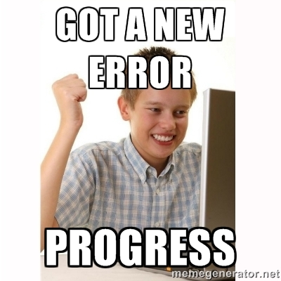
Project #1: Due NEXT TUES!
In P1, we provide you with a simple C++ program that you have to add a few features to.
The goal of P1 is to allow you to self-evaluate to see if you’re ready for CS32.
If you feel lost on P1…
You should seriously consider one of two things:
Drop the class, review your C++, and take CS32 in Spring, or
Suffer… Based on history, you’ll get a C or lower in CS32… ☹

Slide 8




Random Administrative Stuff
We grade on a curve with the average student getting a B-, but if everyone gets above ~90%, everyone gets an A/A-!
But be careful! CS32 is a weeder class! If you take 16 units, be prepared to drop a class! Also… Start CS32 projects EARLY!
Read & sign the academic integrity agreement and don’t cheat – we catch people every year!
We have a special grading policy to discourage cheating on projects. Read the syllabus to understand it!

Slide 9
Compilers, Compilers, Compilers!
You must make sure that your homework/project code works properly with TWO different compilers to get credit!
Test your projects against both compilers at least a day or two before submitting them!
See the CS32 website
http://cs.ucla.edu/classes/winter20/cs32
For all of the gory details!

Slide 10



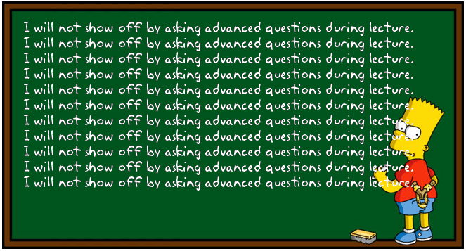




Carey’s Thoughts on Teaching
It’s more important that everyone understand a topic than I finish a lecture on time.
Blah blah blah blah blah
Don’t be shy!!!
If something confuses you…
?
?
?
?
?
it probably confuses 5 other people too.
So always ask questions if you’re confused!
Always save more advanced questions for office hours or break.
I reserve the right to wait until office hours to answer advanced questions.

Slide 11
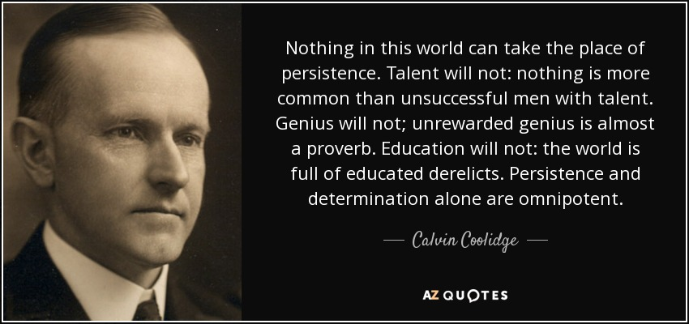


Carey’s Thoughts on CS
Some people just “get” programming…
Others need to work hours and hours on it…
Don’t freak out if you’re in the latter camp.
If you enjoy coding… don’t give up, don’t worry about your grade, just practice and practice and practice.
There’s nothing more important than grit when it comes to programming.
Notes:
www.poll-maker.com

Slide 12

Use Me As a Resource!
If you’re struggling with projects, stressing out on exams, not getting the material, or just need some advice about life.
Come meet with me Schedule a video chat
Let’s talk on the phone
Or grab a coffee
Don’t wait until 8th week when it’s too late!

Slide 13
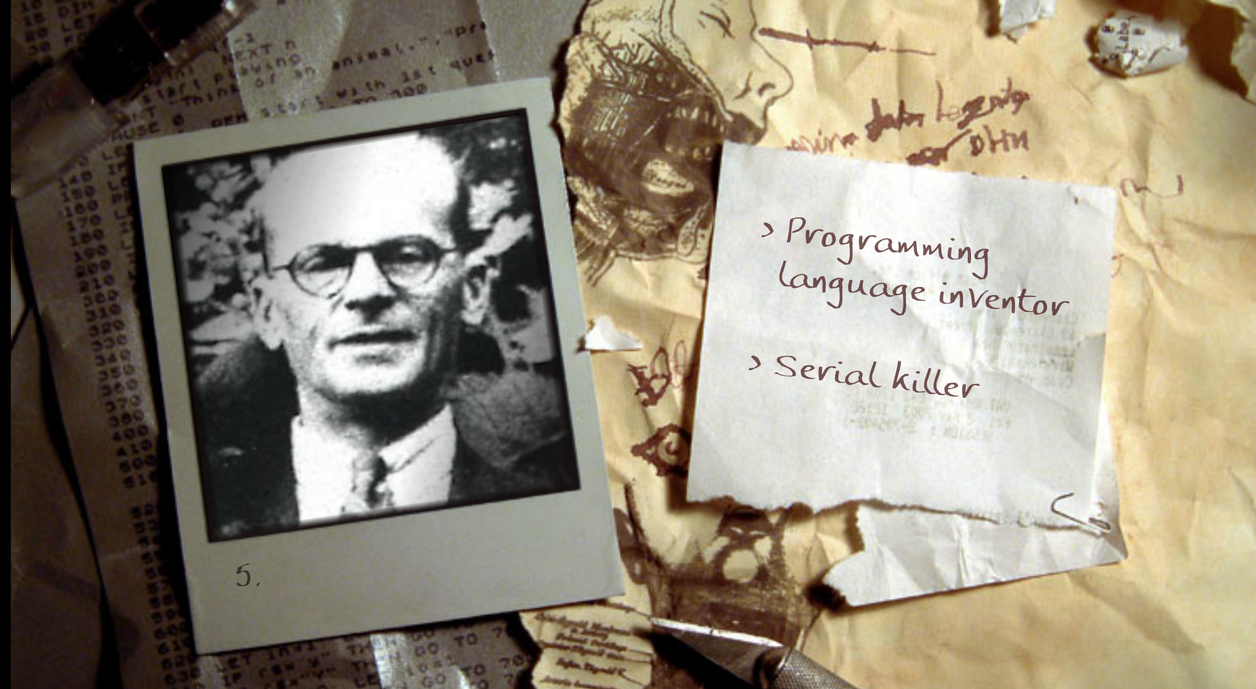
And now for a fun game!
Is this guy a programming language inventor… or a SERIAL KILLER?!?!
Notes:
Killed 8 women in London, was arrested after new tenants tracing an unpleasant odor peeled off the kitchen wallpaper to reveal a corpse.

Slide 14
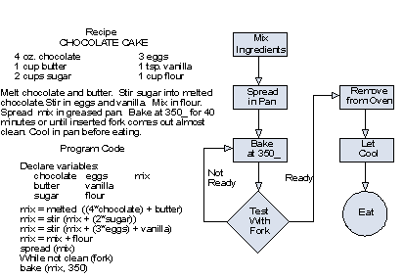
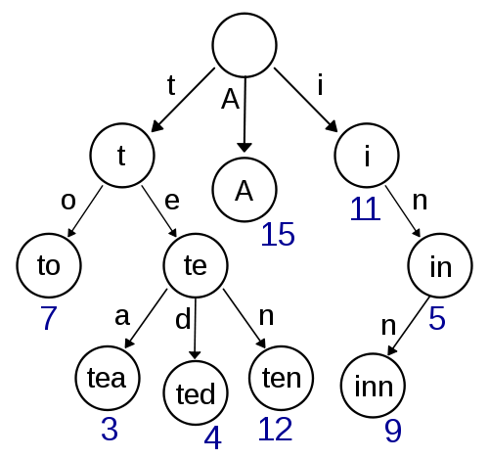
Alright… Enough administration!
Let’s learn about…
Algorithms
Data Structures

Slide 15




What is an Algorithm
An algorithm is a set of instructions/steps that solves a particular problem.
Each algorithm operates on input data.
42
Each algorithm produces an output result.
Each algorithm can be classified by how long it takes to run on a particular input.
Each algorithm can be classified by the quality of its results.

Slide 16
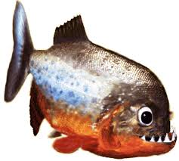
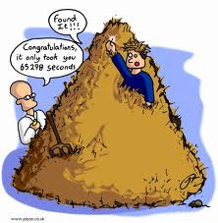
Algorithm Comparison “Guess My Word”
Let’s say you’re building a word guessing game.
The user secretly picks a random word from the dictionary.
ichthyology
Our program then must discover the word the user picked as quickly as possible.
Let’s consider two different algorithms…

Slide 17
Algorithm #1: Linear Search
Let’s try a simple algorithm: We’ll search linearly from top to bottom and ask the user about each word:
Start with the first word in the dictionary
While I haven’t reached the end of the dictionary
{
Read the current word out loud to the user
Ask the user: “Is this the word you picked?”
If they answer “Yes!”, you’re done!
Otherwise advance to the next word
}
Question: If there are 100,000 total words in our dictionary, on average, how many guesses will our algorithm require?
Ok, let’s try it.
Notes:
Answer: Roughly N/2 guesses, on average, to guess the user’s word

Slide 18
Algorithm #2: Binary Search
Alright, for our second strategy let’s try a more intelligent approach called binary search:
SearchArea = The entire dictionary
While I haven’t guessed the user’s word
{
Pick the middle word w in the SearchArea
Ask the user: “Is w your word?”
If so, you’re done! Woohoo!
If not, ask: “Does your word come before or after w?”
If their word comes before our middle word w
SearchArea = first ½ of the current SearchArea
If their word comes after our middle word w
SearchArea = second ½ of the current SearchArea
}
Ok, let’s try it.
Question: If there are 100,000 total words in our dictionary, on average, how many guesses will our Binary Search algorithm require?
Notes:
Answer, log (n) (that’s log with a base of 2)
2

Slide 19
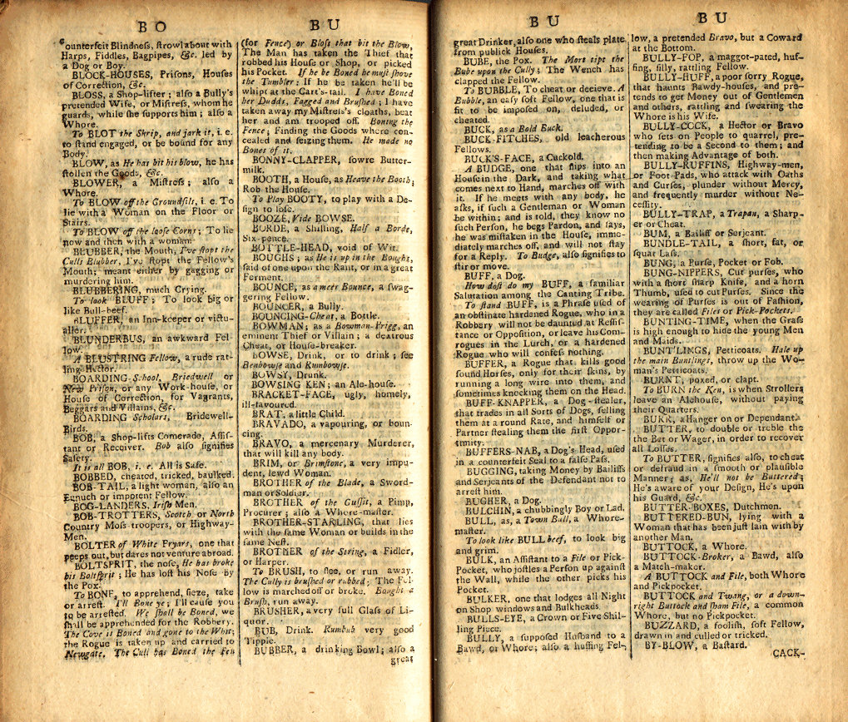
Binary Search: How Many Guesses?
We keep on dividing our search area in half until we finally arrive at our word.
In the worst case, we must keep halving our search area until it contains just a single word – our word!
If our dictionary had 16 words, how many times would we need to halve it until we have just one word left?
16
8
4
2
1
It would take 4 steps
Ok, what if our dictionary had 131,072 words?
131072
65536
32768
16384
8192
4096
2048
1024
512
256
128
64
32
16
8
4
2
1
It would take just 17 steps!!! WOW!

Slide 20
Wow! That’s Significant!
Our linear search algorithm requires an average of 50,000 steps to guess the user’s secret word from a 100k word dictionary.
But our binary search algorithm requires just 17 steps, on average, to guess the user’s secret word!
In CS32, you’ll learn all of the major algorithms and how to analyze different algorithms so you can pick the best one for each task!

Slide 21

Data Structures
A data structure is the set of variable(s) that an algorithm uses to solve a problem.
Now with the right algorithm…
Does David…
A data structure could be as simple as an array…
Cold
0
Flu
have Herpes?
1
we can answer questions like…
Herpes
2
Measles
3
Rabies
4
0 1 2 3 4
Cedric
0
0
1
2
3
4
5
6
F
F
T
F
F
David
1
T
F
F
F
T
Or could have a more elaborate structure…
Or could have a more elaborate structure…
Or could have a more elaborate structure…
F
F
F
T
T
Isaac
2
Algorithm
1. Find the person’s row #.
2. Find the disease’s column #.
3. If the cell has True in it, the person has had that disease.
James
3
F
T
F
F
F
Nincy
4
T
F
T
F
F
Nora
5
F
F
F
F
F
Sally
6
F
T
F
F
F

Slide 22
Data Structures
Choosing the right data structure can make your algorithms far more efficient!
So in addition to learning all of the major algorithms this quarter…
You’ll also learn all of the most powerful data structures in CS32!

Slide 23
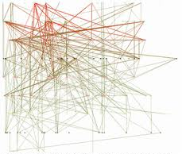
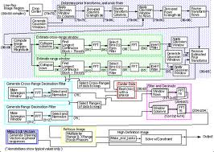
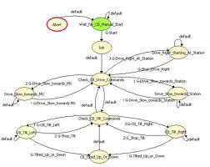

Data Structures + Algorithms = Confusion!
Without having to understand any of the sordid details!
Of course, your data structures and algorithms can get quite complex.
Cedric
0
0 1 2 3 4
David
1
0
1
2
3
4
5
6
F
F
T
F
F
Algorithm
1. Find the person’s row #.
2. Find the disease’s column #.
3. If the cell has True in it, the person has had that disease.
Isaac
2
T
F
F
F
Such a collection of simple functions is called an “interface.”
James
3
T
Linda
4
F
F
F
T
T
Cold
0
Nora
5
F
T
F
F
F
Sally
Flu
1
6
Herpes
2
T
F
T
F
F
Measles
3
F
F
F
F
F
Rabies
4
F
T
F
F
F
If you gave your code to another programmer, he/she would have no idea how to use it!
An interface lets any programmer use your code…
Therefore, every time you create a new set of data structures/algorithms, it helps to also create a few simple functions that hide the gory details…
int main()
{
infectPerson(“Linda”, “Cold”);
if (hasDisease(“David”, ”Herpes”) == true) cout << “Time to go to the Ashe center!\n”;
}
bool hasDisease(string person, string disease);
void infectPerson(string person, string disease);
void curePerson(string person, string disease);

Slide 24
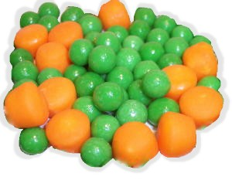
Algorithms & Data Structures Are a Perfect Couple!
Algorithms and data structures are like peas and carrots – they belong together!
To solve a problem, you have to design both the algorithms and the data structures together.
Then you provide a set of simple “interface” functions to let any programmer use them easily.
And in fact, we even have a name for such a (data structure + algorithm + interface) solution to a problem…

Slide 25
The Abstract Data Type (ADT)
An Abstract Data Type or ADT is:
A coordinated group of
data structures, (b) algorithms and (c) interface functions
that is used to solve a particular problem.
I’m an interface.
If someone wants to use this ADT, he/she must call these three functions to work with it.
I’m a set of algorithms.
No one outside of my ADT needs to know how I work.
I’m a set of data structures.
No one outside of my ADT needs to know what I look like!
Abstract Data Type (for tracking diseases)
0 1 2 3 4
0
1
2
3
4
5
6
F
F
T
F
F
hasDisease() Algorithm
1. Find the person’s row #.
2. Find the disease’s column #.
3. If the cell has True in it, the person has had that disease.
…
bool hasDisease(string person, string disease)
void infectPerson(string person, string disease)
void curePerson(string person, string disease)
Cedric
T
F
F
F
T
0
+
+
David
1
F
F
F
T
T
Isaac
2
James
F
T
F
F
F
Cold
3
T
0
Linda
F
T
F
F
Flu
4
Nora
1
5
F
F
F
F
F
Herpes
2
Sally
6
F
T
F
F
F
Measles
3
Rabies
4
In an ADT, the data structures and algorithms are secret.
The ADT provides an interface (a simple set of functions) to enable the rest of the program to use the ADT.
Typically, we build programs from a collection of ADTs, each of which solves a different sub-problem.

Slide 26

ADTs in C++
0
1
2
3
4
5
6
F
F
T
F
F
In C++, we use classes to define ADTs in our programs!
Each C++ class can hold algorithms, data and interface funcs.
Cedric
0
T
F
F
F
T
David
1
F
F
F
T
T
Isaac
2
F
T
F
F
F
James
hasDisease() Algorithm
1. Find the person’s row #.
2. Find the disease’s column #.
3. If the cell has True in it, the person has had that disease.
Cold
3
Linda
0
T
F
T
F
F
Flu
4
1
int main()
{
DiseaseTracker x;
x.infectPerson(“Carey”, ”Cooties”);
x. infectPerson(“David”,
”Explosive Diarrhea”);
…
string person, disease;
cin >> person >> disease;
if (x.hasDisease(person, disease) == true)
cout << person << “ has got “ << disease;
}
Nora
5
F
F
F
F
F
Herpes
2
Once we’ve defined our class, the rest of our program can use it trivially.
All our program needs to do is call the functions in our class’s public interface!
And yet all of its underlying data structures and algorithms are hidden!
The rest of the program can ignore the details of how our class works and just use its features!
Sally
6
F
T
F
F
F
// A C++ disease tracking class…
// (this is really an ADT!)
class DiseaseTracker
{
public:
private:
};
Measles
3
Rabies
4
// our interface functions go here
void hasDisease(…);
void infectPerson(…);
...
// secret algorithms go here
…
// secret data structures go here
…

Slide 27
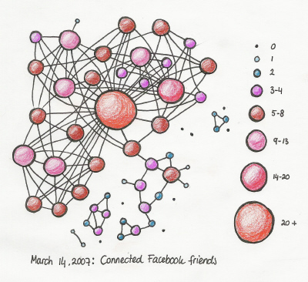
ADTs in C++
Person Address
Carey 0xB5A4
Scott 0x7198
David 0x9CF2
Danny 0xD99D Jenny 0x7DEE
Rich Lim 5
David Sun 6
…
0
1
2
3
4
5
6
F
F
T
F
F
Cedric
0
T
F
F
F
T
David
1
F
F
F
T
T
Now what if I wanted to improve my class’s data structures and algorithms?
Isaac
2
F
T
F
F
F
James
hasDisease() Algorithm
1. Find the person’s row #.
2. Find the disease’s column #.
3. If the cell has True in it, the person has had that disease.
Cold
3
0
T
F
T
F
F
hasDisaese() Algorithm:
1. Identify the node in the graph for user
2. Perform a breadth-first search from this node
3. Do not follow more than 2 edges…
Linda
4
This is the power of ADTs (and of classes)!
If you design your programs using this approach, you can reduce complexity by:
Breaking your programs up into small, self-contained chunks.
Combining these chunks together to solve bigger (more complex) problems.
Flu
1
int main()
{
DiseaseTracker x;
x.infectPerson(“Carey”, ”Cooties”);
x. infectPerson(“David”,
”Explosive Diarrhea”);
…
string person, disease;
cin >> person >> disease;
if (x.hasDisease(person, disease) == true)
cout << person << “ has got “ << disease;
}
Nora
5
F
F
F
F
F
Herpes
2
Sally
6
F
T
F
F
F
Measles
3
Rabies
4
Let’s say I made a radical change to my disease tracker data structures…
Would the user of my class need to change any part of her program?
No! Because the rest of the program doesn’t rely on these details - it knows nothing about them!

Slide 28
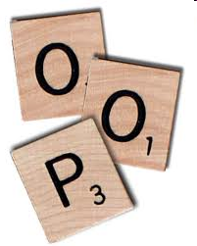
What is Object Oriented Programming?
Object Oriented Programming (OOP) is simply a programming model based on the Abstract Data Type (ADT) concept we just learned!
In OOP, programs are constructed from multiple self-contained classes.
Each class holds a set of data and algorithms - we then access the class using a simple set of interface functions!
Classes talk to each other only by using public interface functions – each class knows nothing about how the others work inside.
So to sum up:
OOP is using classes (aka ADTs) to build programs – plus some other goodies we’ll learn soon!

Slide 29
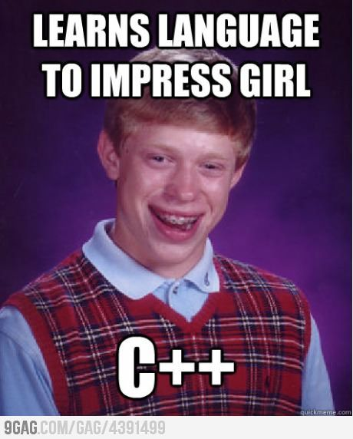
Intermission Meme

Slide 30


C++ Class Review
As we’ve seen, a “class” is a self-contained problem solver that contains:
Data structures
Algorithms
Interface functions
Since you’ve probably forgotten everything about classes…
Let’s do a quick review of classes by defining our own Nerd class!

Slide 31
Defining a New Class
class
Nerd
{
}
First, we write the outer shell of our class and give it a name.
public:
void init() { myStinkiness = 0; myIQ = 100; }
Then we define our class’s public interface functions…
void study(int hours) { myStinkiness += 3*hours; myIQ *= 1.01; }
Then we define our class’s private variables and functions…
int getStinkyLevel() { int total_stink = myIQ * 10 +
myStinkiness;
return total_stink;
}
Our class defines an entirely new data type, like string, that we can now use in our program.
private:
Alert: Nerd is not a variable! It’s a new C++ data type!
void takeShower()
{ m_stinkiness /= 2; }
int myStinkiness, myIQ;
;

Slide 32
Using a New Class
nerd.h
class Nerd
{
public:
void init() { myStinkiness = 0; myIQ = 100; }
void study(int hours) { myStinkiness += 3*hours; myIQ *= 1.01; }
…
private:
int myStinkiness, myIQ;
};
Once we define a new class, like Nerd, we can use it to define variables like any traditional data type.
You typically define each new class in its own header file.
To use your new class, simply include its header file using quotation marks…
ucla.cpp
#include “nerd.h”
Just as num_nerds is an integer variable…
And then define variables with it throughout your program.
int main()
{
int num_nerds = 1;
Nerd david;
david.init();
}
david is a Nerd variable.

Slide 33
Using a New Class
nerd.h
class Nerd
{
public:
void init() { myStinkiness = 0; myIQ = 100; }
void study(int hours) { myStinkiness += 3*hours; myIQ *= 1.01; }
…
private:
int myStinkiness, myIQ;
};
Alright, let’s see our class in action!
void init() { myStinkiness = 0; myIQ = 100; }
void study(int hours) { myStinkiness += 3*hours; myIQ *= 1.01; }
…
num_nerds
1
david
0
100
It has access to david’s member variables!
myStinkiness
myIQ
-79342
12338
ucla.cpp
#include “nerd.h”
When we call one of david’s member functions, this calls the version of the function inside the david variable.
Note: A class’s primitive member variables (e.g. int’s, doubles) all start out with random values!
int main()
{
int num_nerds = 1;
Nerd david;
david.init();
}
When you define your david variable, it gets its own copy of all of the functions and member variables defined in your class!

Slide 34
Other Details
nerd.h
class Nerd
{
public:
void init() { myStinkiness = 0; myIQ = 100; }
void study(int hours) { myStinkiness += 3*hours; myIQ *= 1.01; }
…
private:
int myStinkiness, myIQ;
};
You typically only use member variables to store permanent attributes of your class.
Stinkiness and IQ are inherent attributes of every Nerd.
So we make these member variables.
int getStinkyLevel() { int total_stink = myIQ * 10 + myStinkiness;
return total_stink;
}
total_stink
On the other hand, we use local variables for temporary computations.
ucla.cpp
#include “nerd.h”
int main()
{
int num_nerds = 1;
Nerd david;
david.init();
}

Slide 35
Other Details
nerd.h
class Nerd
{
public:
void init() { myStinkiness = 0; myIQ = 100; }
void study(int hours) { myStinkiness += 3*hours; myIQ *= 1.01; }
…
private:
int myStinkiness, myIQ;
};
So they can only be accessed by your class’s member functions.
C++ strictly enforces class privacy!
Hiding the internal details of a class is called “encapsulation.”
All functions in the public section can be used by all parts of your program.
All functions in the public section can be used by all parts of your program.
However, these members are private.
ucla.cpp
#include “nerd.h”
int main()
{
int num_nerds = 1;
Nerd david;
david.init();
}
For instance, here we see our main() function using Nerd’s public init() function!
Code outside your class can’t directly access them, however.
cout << david.myStinkiness;
ERROR!

